Slide 1
Transcriptomics Data

Slide 2
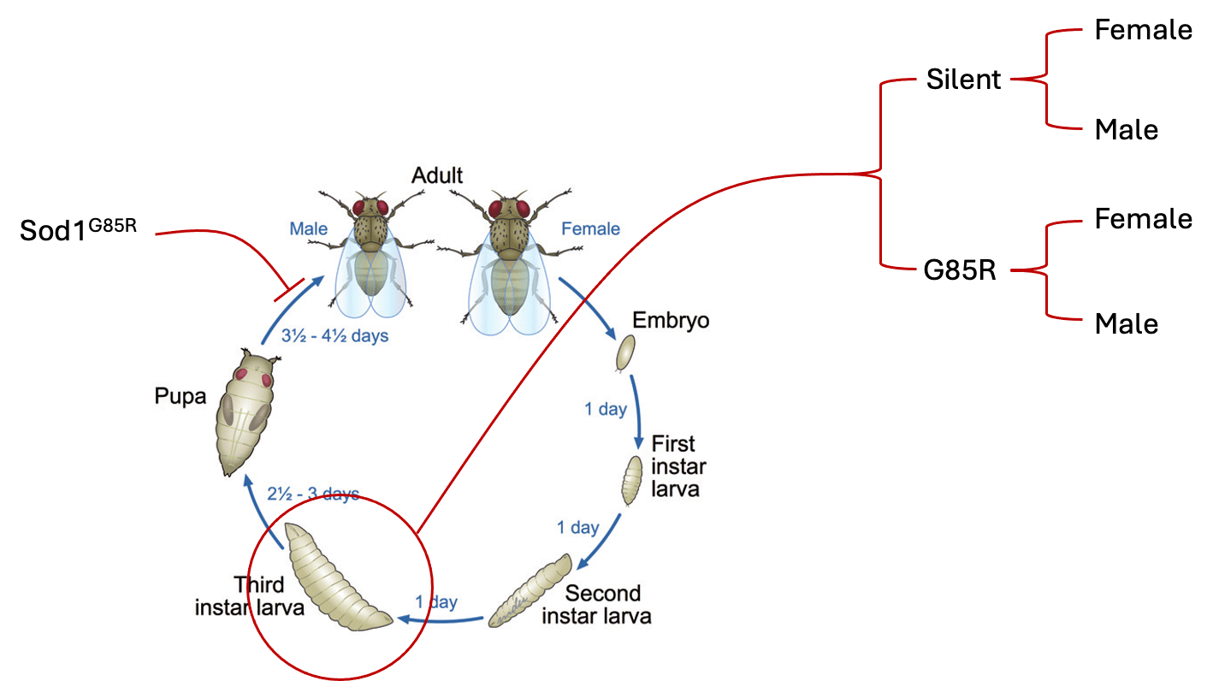
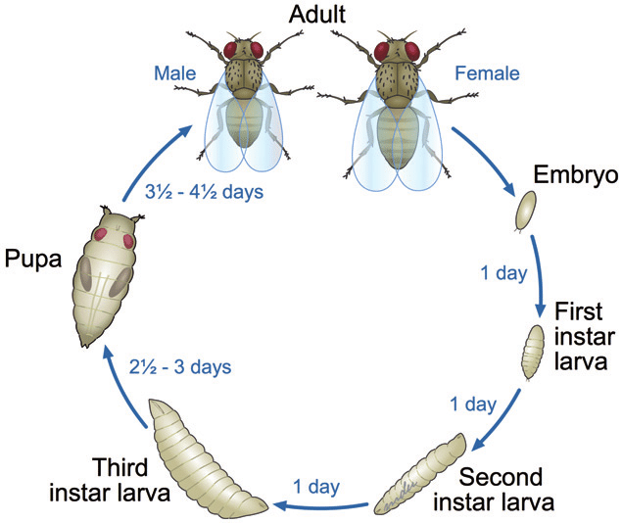
SOD1^{G85R} RNAseq Experimental Design
Female
Silent
Male
Female
RNAseq
Sod1^{G85R}
G85R
Male
Sod1^{G85R} flies are unable to eclose
We performed RNAseq Sod1^{G85R} and Silent 3rd instar larvae (whole body) separated by sex

Slide 3
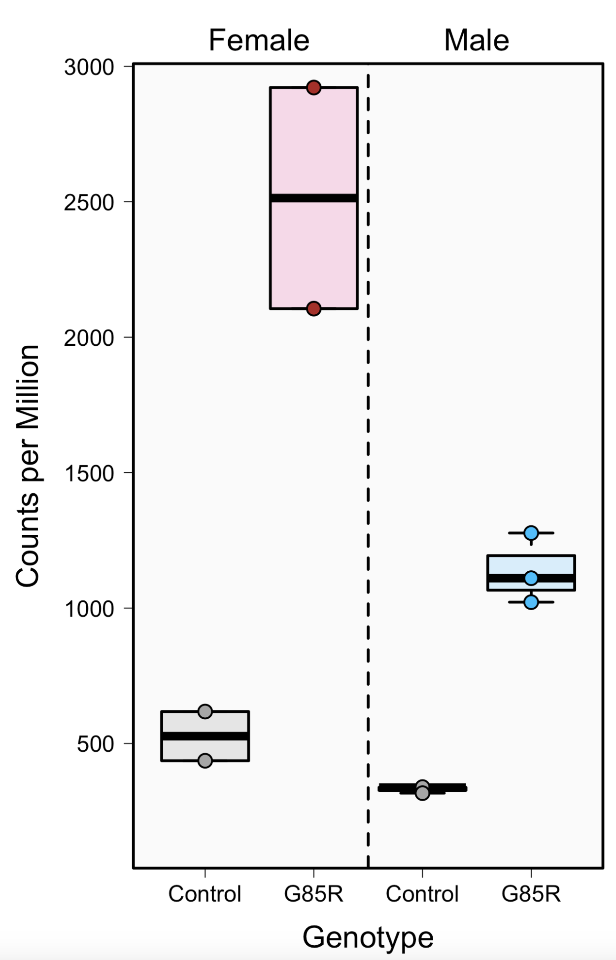
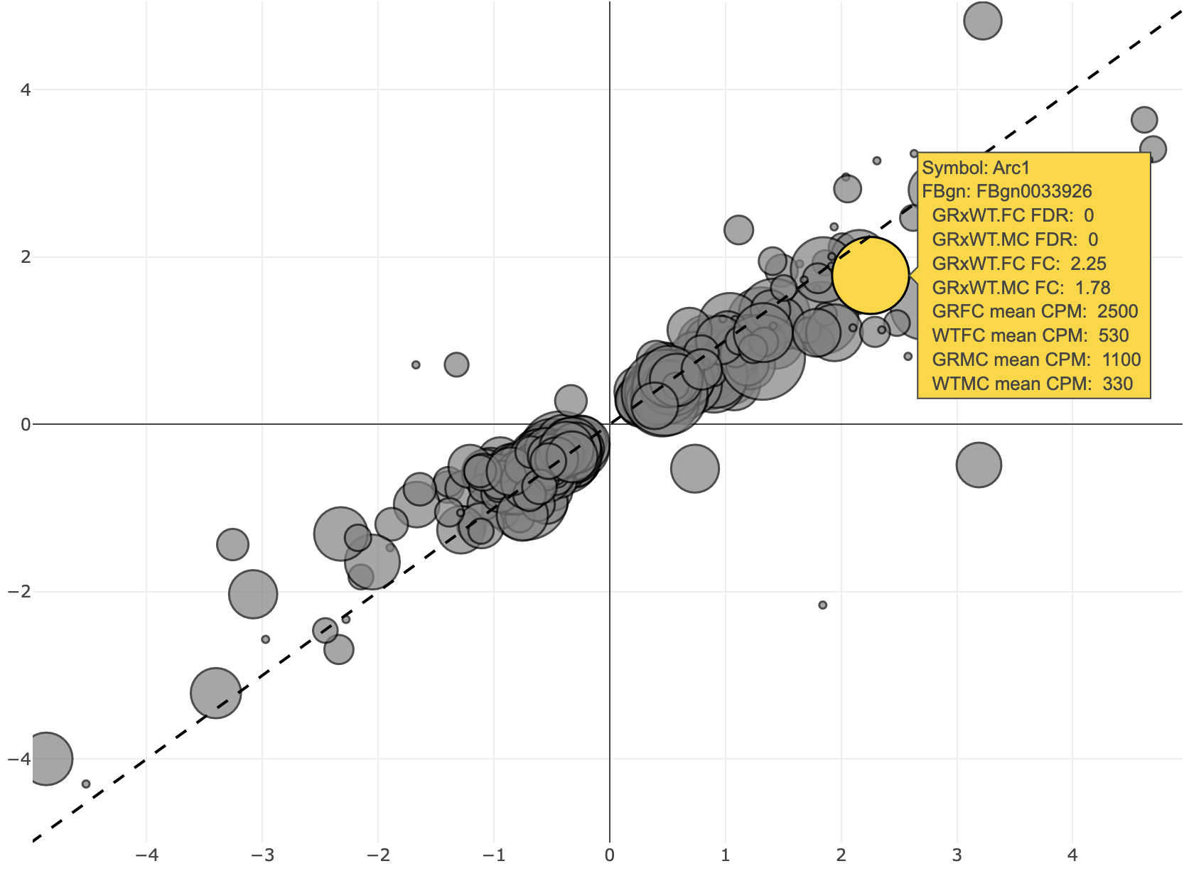
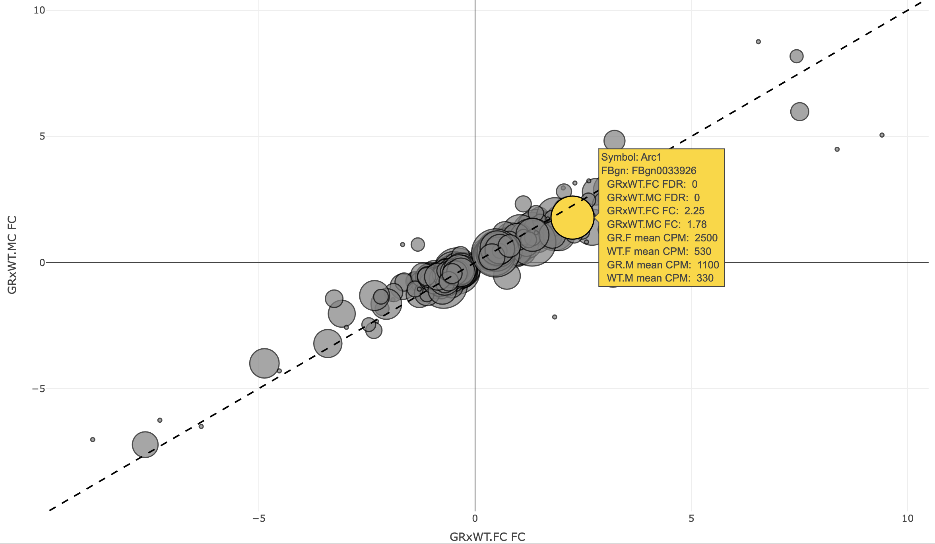
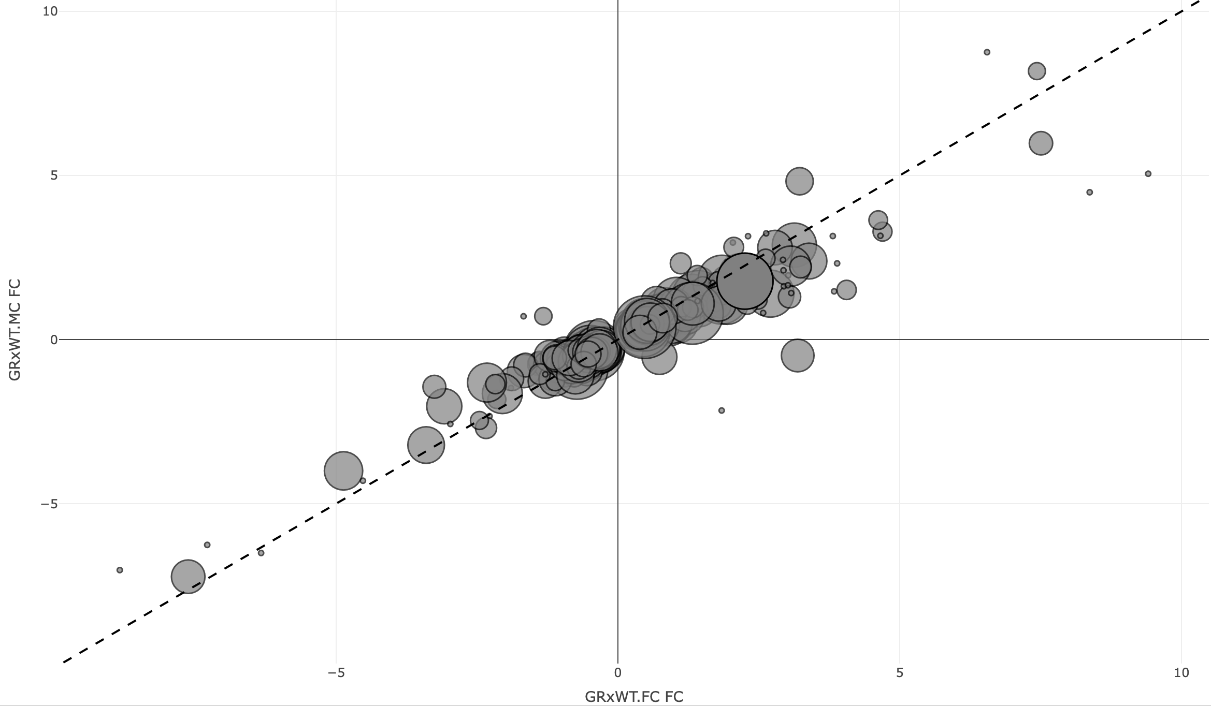
Arc1 Increased Expression in G85R Transcriptome Analysis
Female and Male Relative Gene Expression (G85R/WT)
Arc1
Male –log2(FC)
Female –log2(FC)

Slide 4
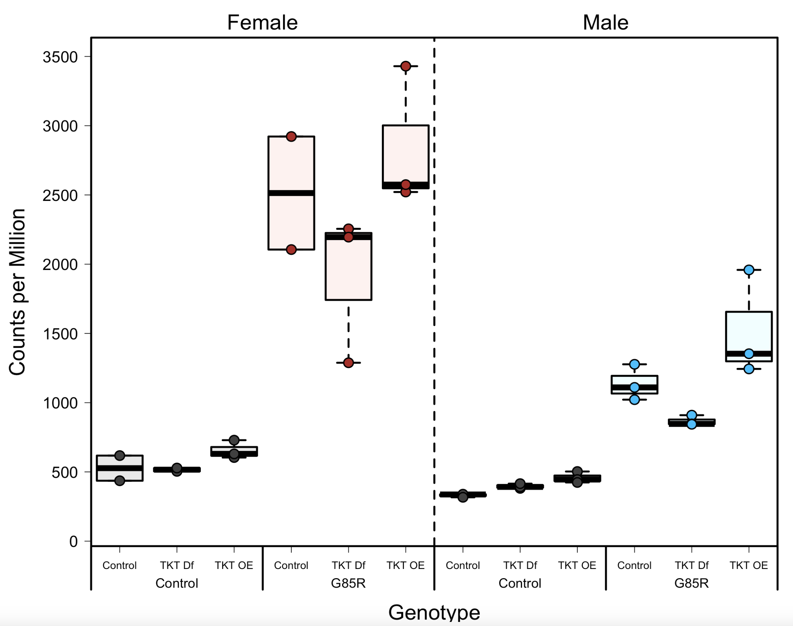
G85R arc1 increase observed in other conditions
Arc1
The G85R RNAseq data was part of a larger experiment with modulated transketolase
Arc1 gene expression was observed consistently across these other experimental conditions

Slide 5

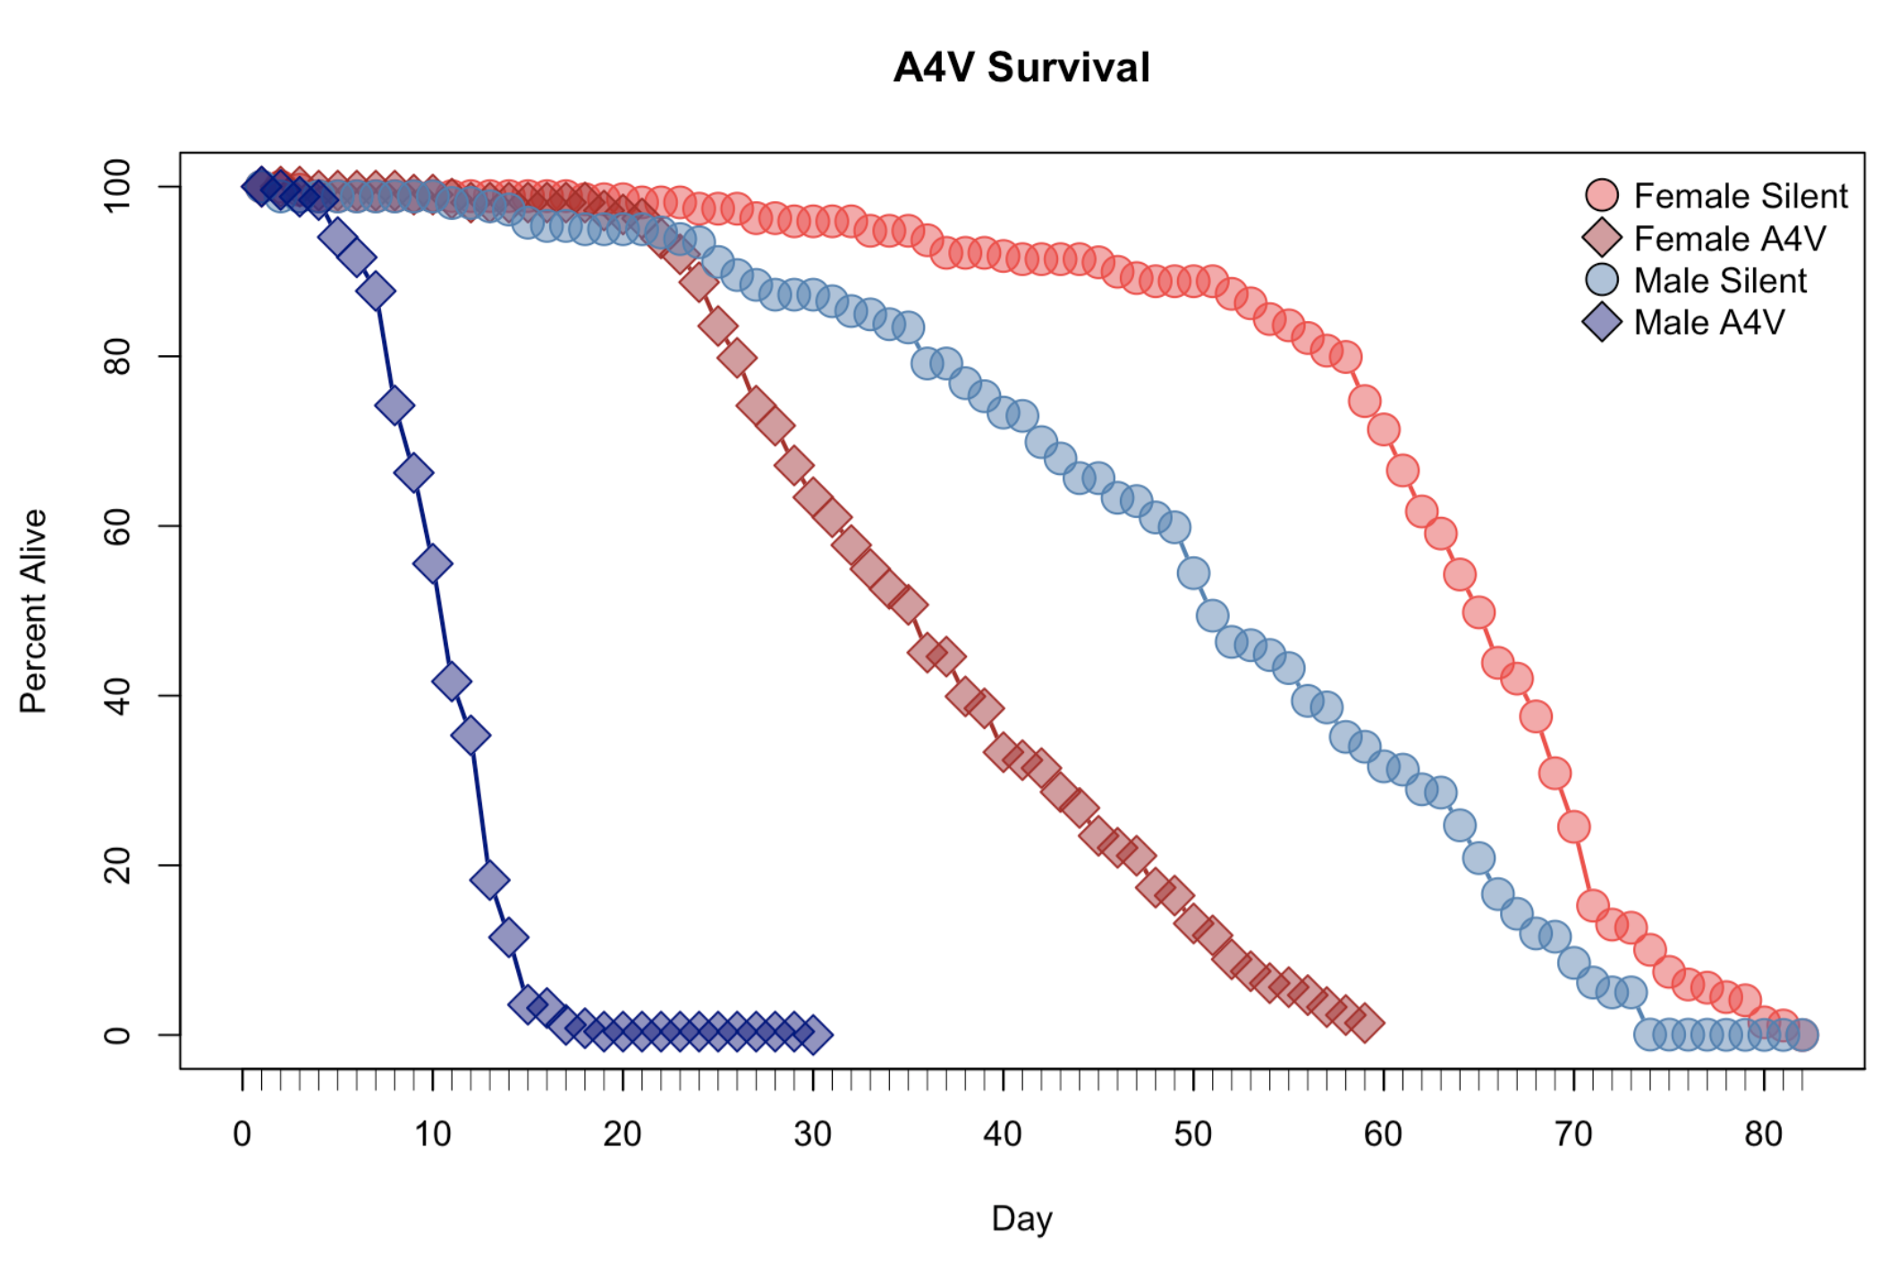
Sod1^{A4V} RNAseq Experimental Design
Head
Thorax
Sod1^{A4V} flies have sex specific decreased lifespan
Sod1^{A4V} and Silent adults at 3, 9, and 40 days, old separated by sex
Samples were separated into 3 body sections before RNAseq
Abdomen
Sod1^{A4V} flies have sex specific decreased lifespan
We performed RNAseq on Sod1^{A4V} and Silent adulst at 3, 9, and 40 days old separated by sex

Slide 6
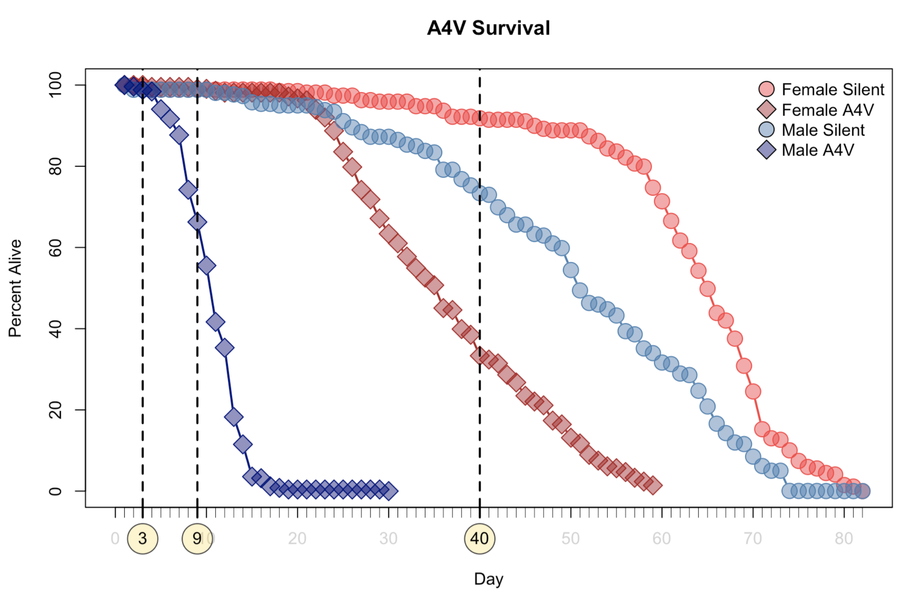
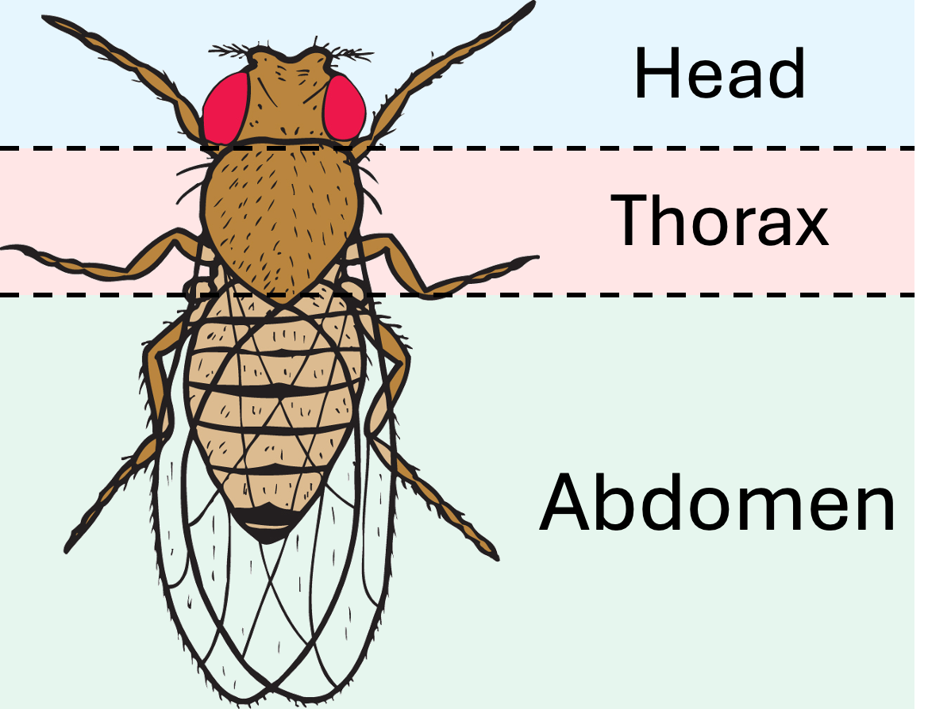
Sod1^{A4V} RNAseq Experimental Design
Sod1^{A4V} flies have sex specific decreased lifespan
Sod1^{A4V} and Silent adults at 3, 9, and 40 days, old separated by sex
Samples were separated into 3 body sections before RNAseq

Slide 7
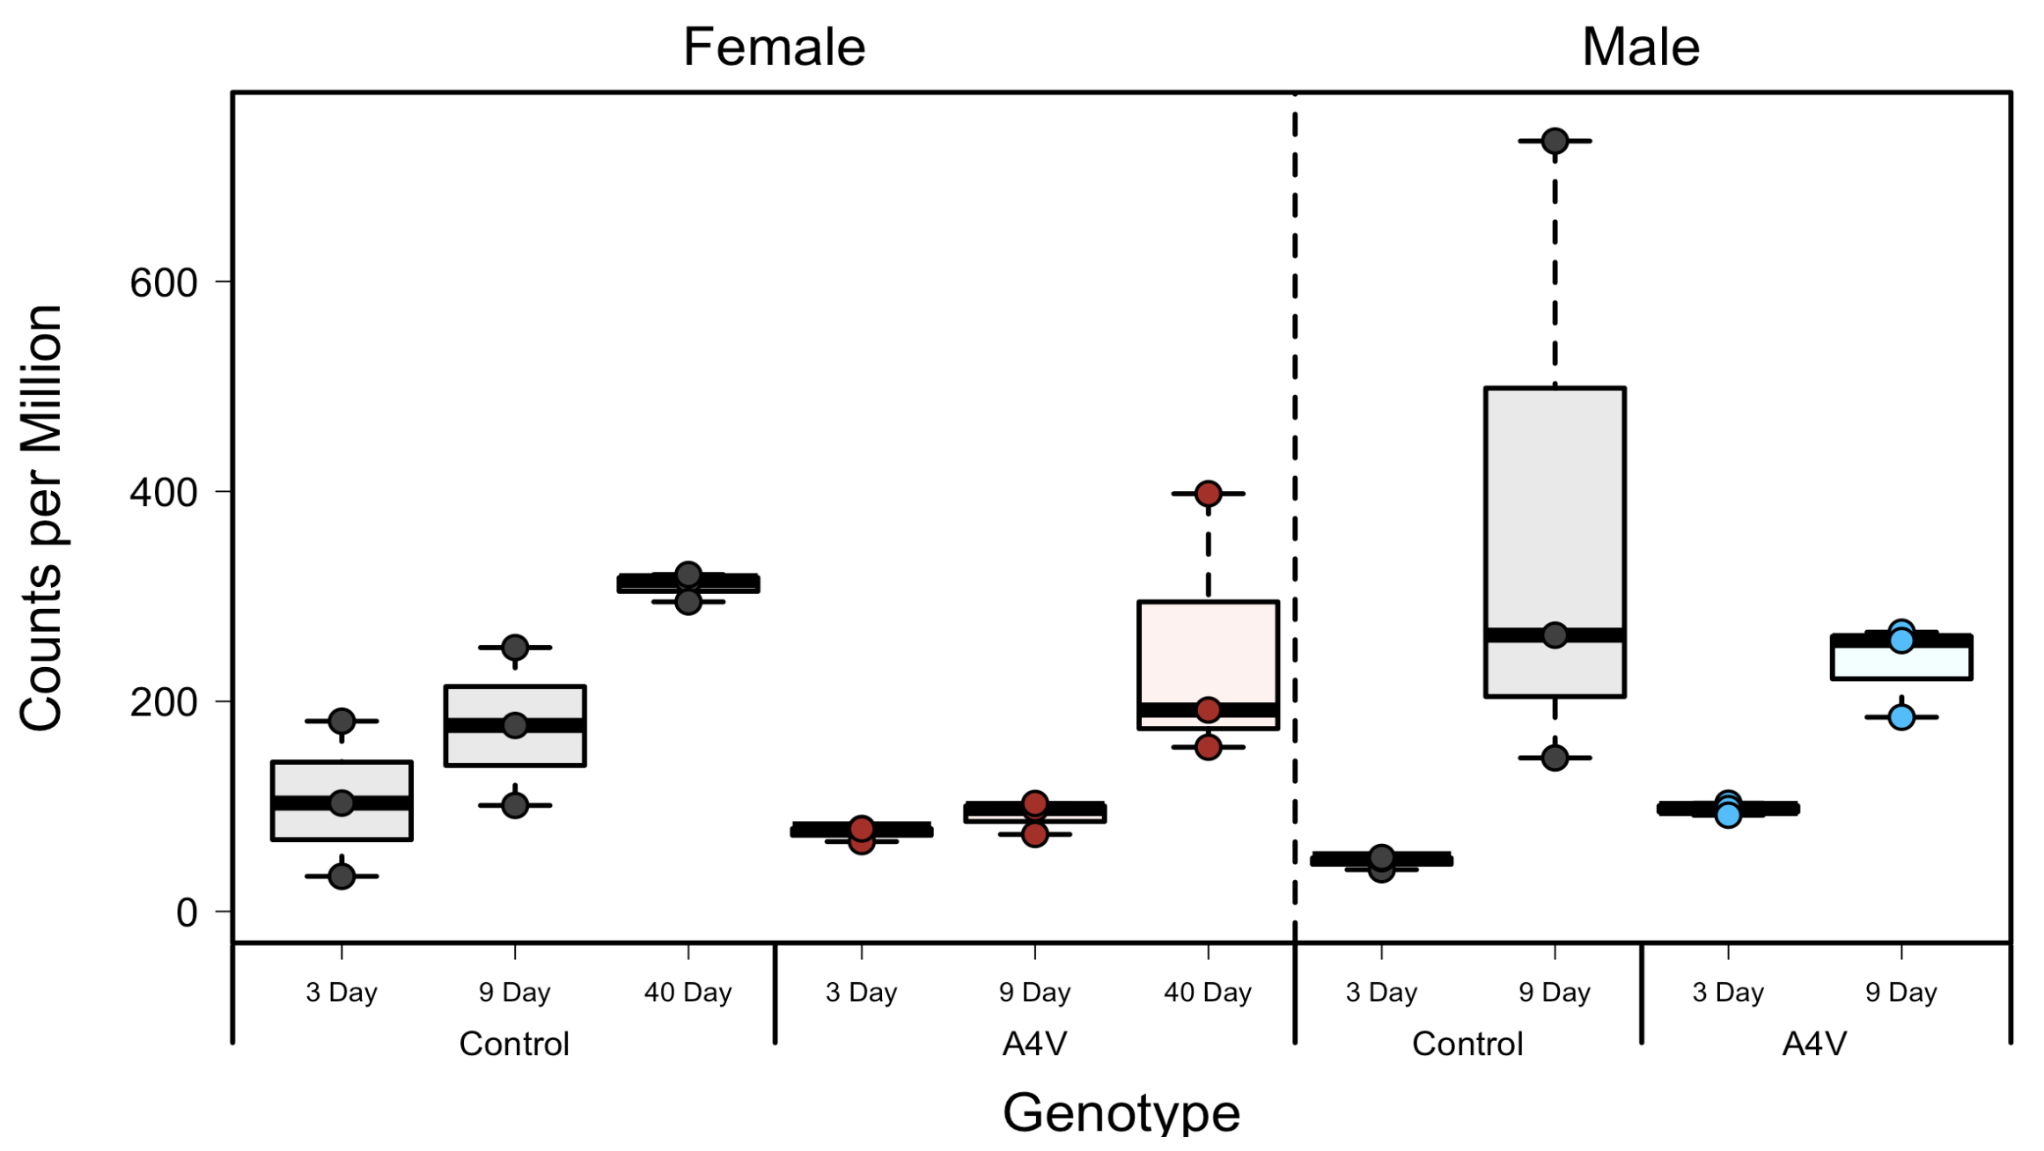
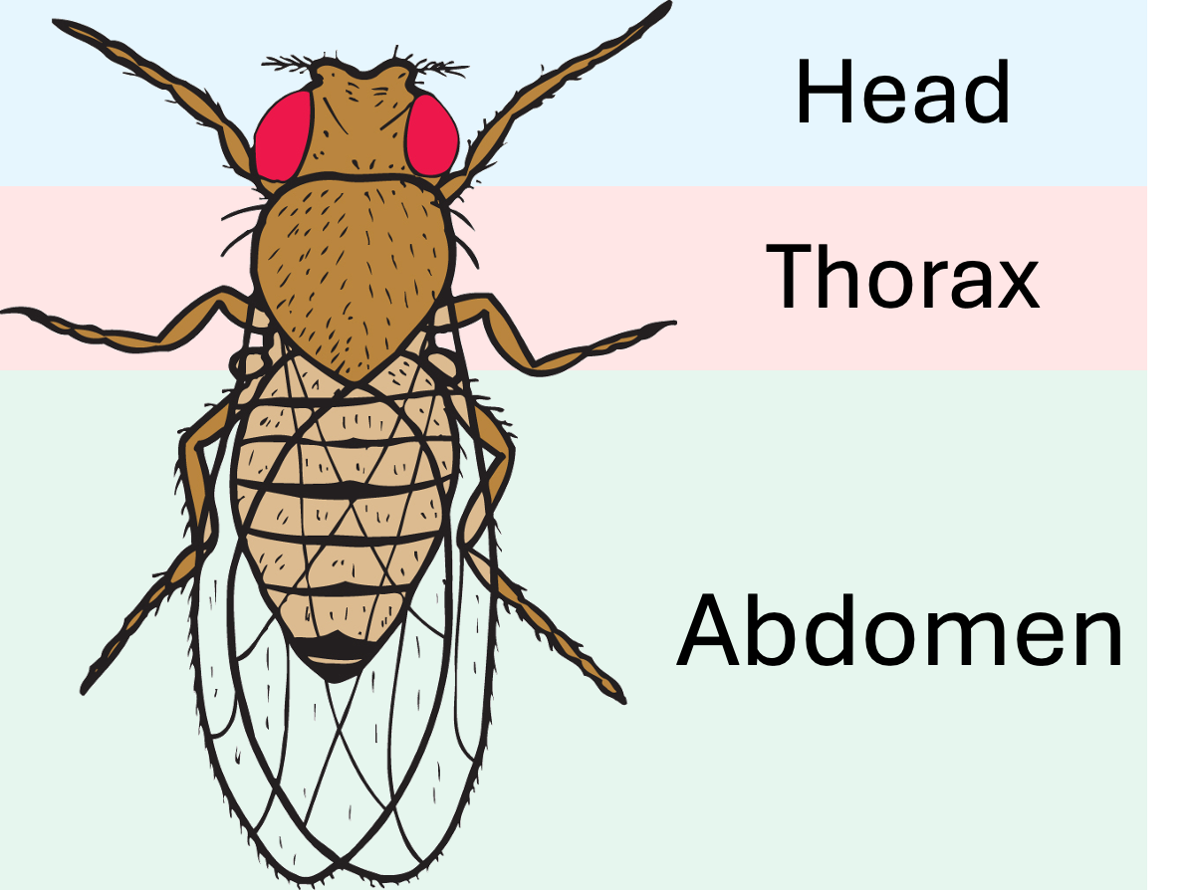
Arc1 Expression in Sod1^{A4V} Head
Sod1^{A4V} flies have sex specific decreased lifespan
Sod1^{A4V} and Silent adults at 3, 9, and 40 days, old separated by sex
Samples were separated into 3 body sections before RNAseq

Slide 8
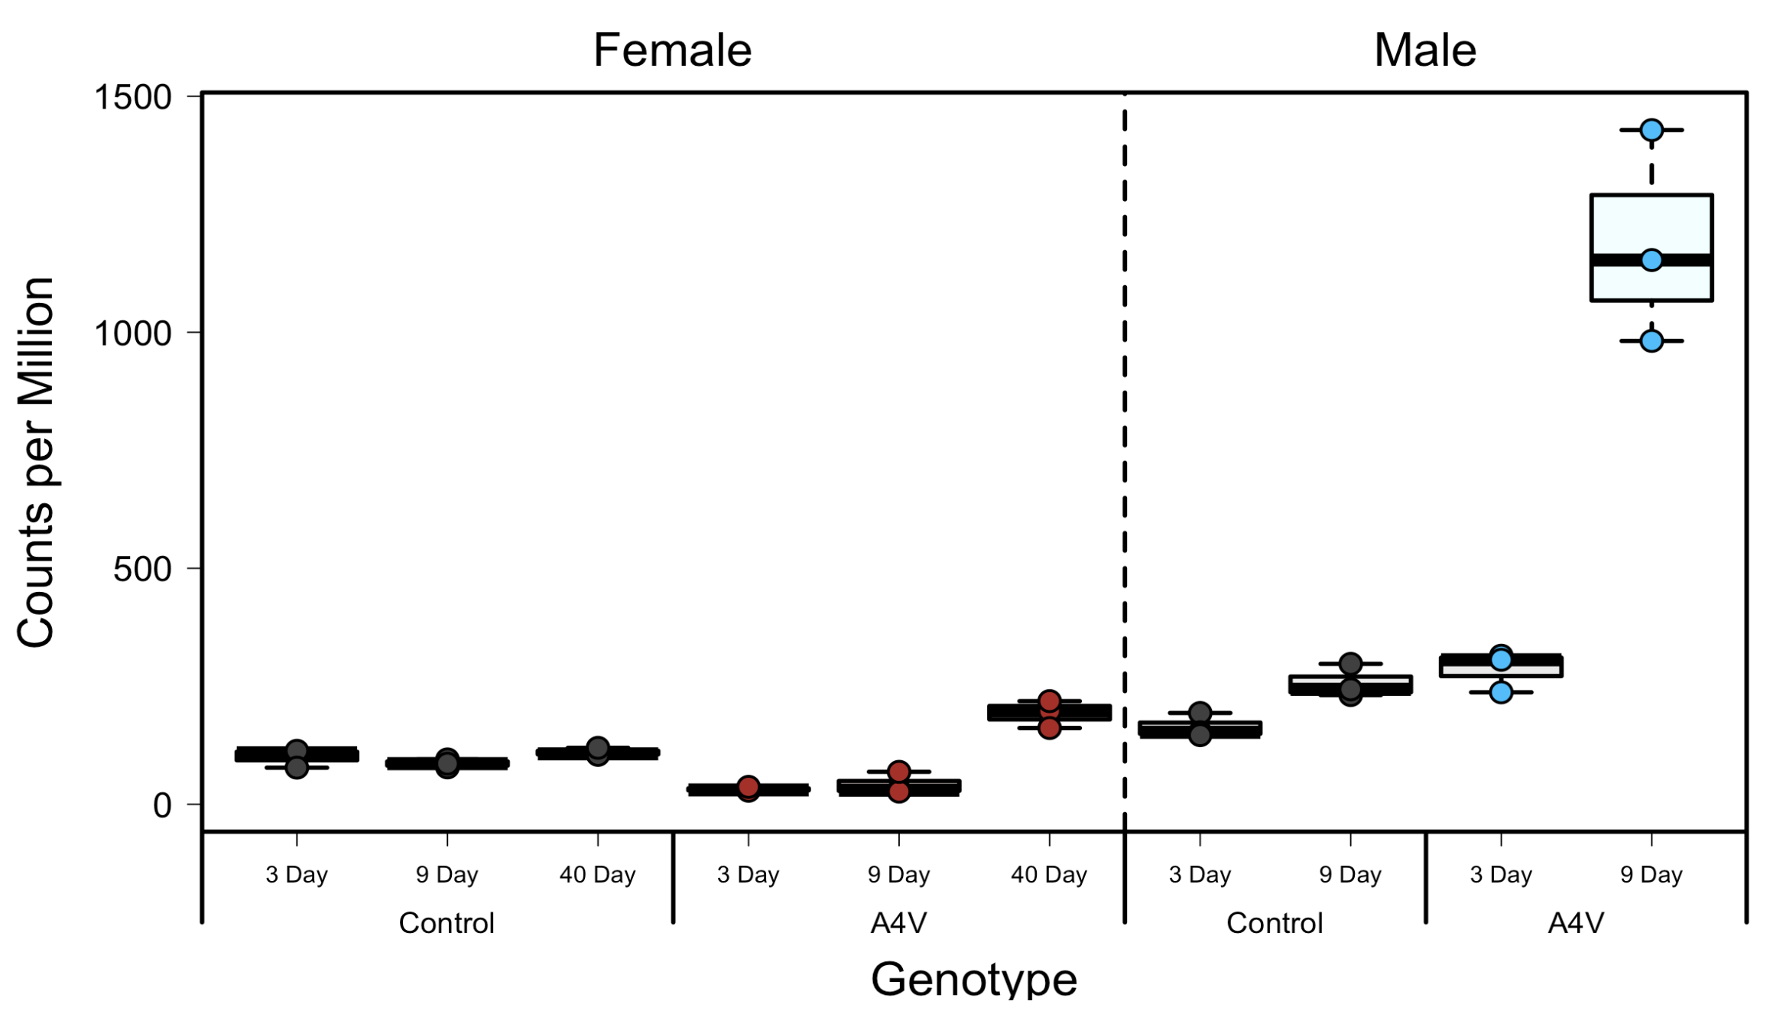
Arc1 Expression in Sod1^{A4V} Abdomen
Sod1^{A4V} flies have sex specific decreased lifespan
Sod1^{A4V} and Silent adults at 3, 9, and 40 days, old separated by sex
Samples were separated into 3 body sections before RNAseq

Slide 9
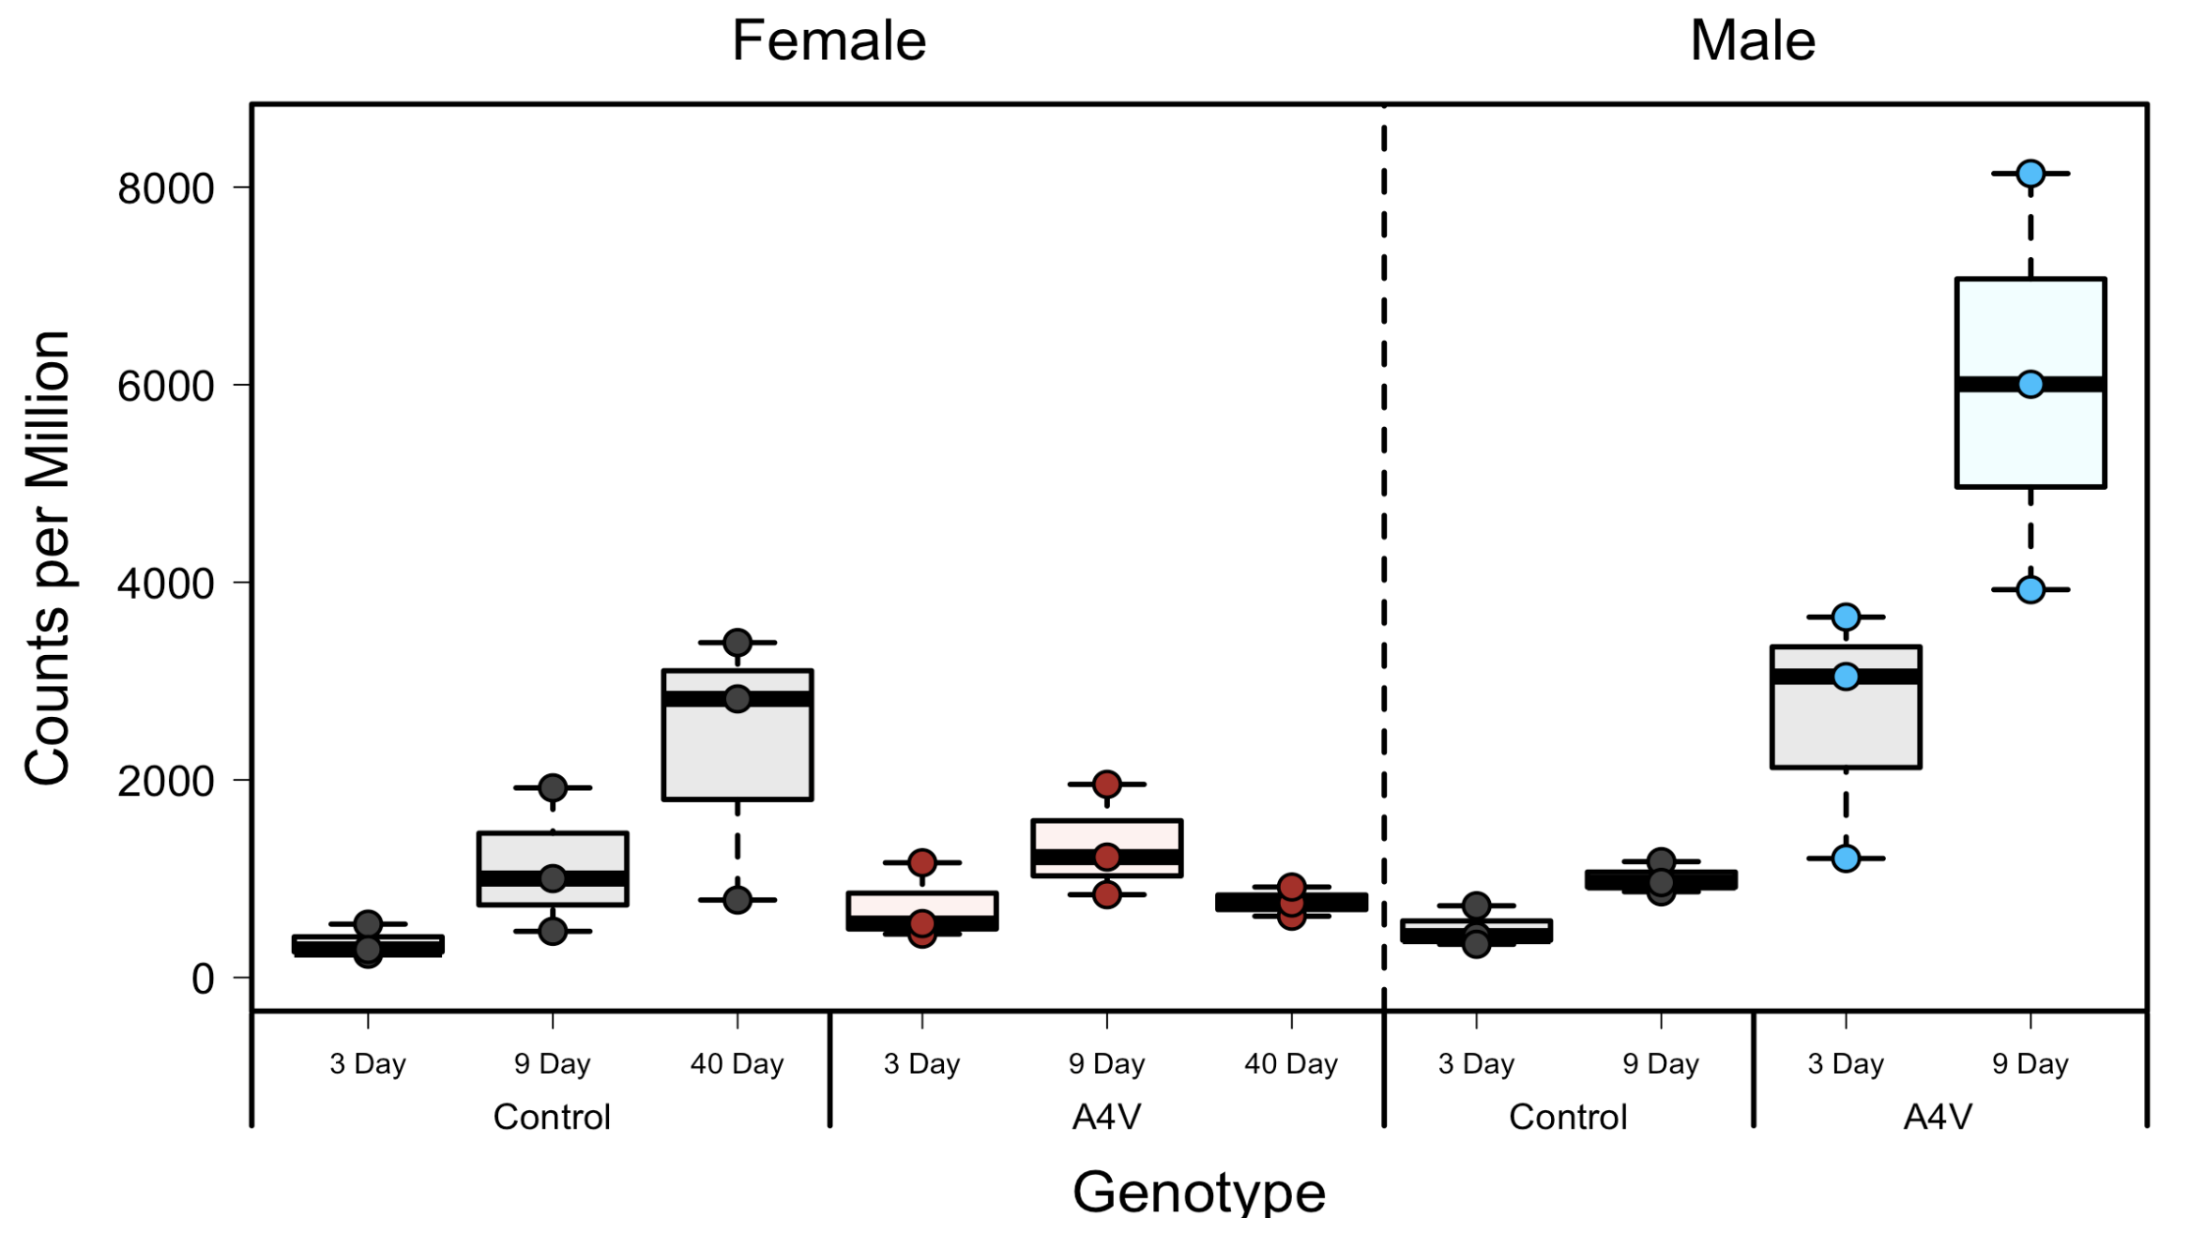
Arc1 Expression in Sod1^{A4V} Thorax
Sod1^{A4V} flies have sex specific decreased lifespan
Sod1^{A4V} and Silent adults at 3, 9, and 40 days, old separated by sex
Samples were separated into 3 body sections before RNAseq

Slide 10
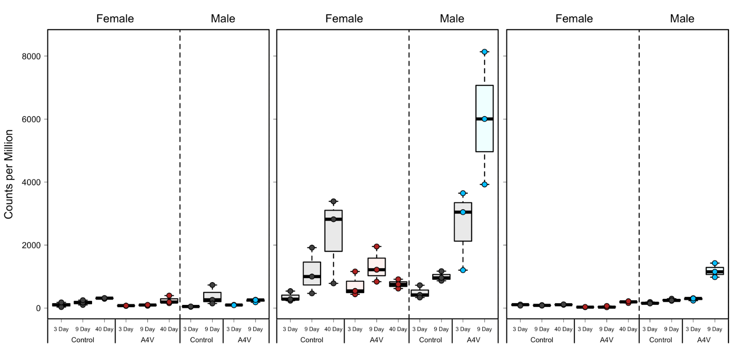
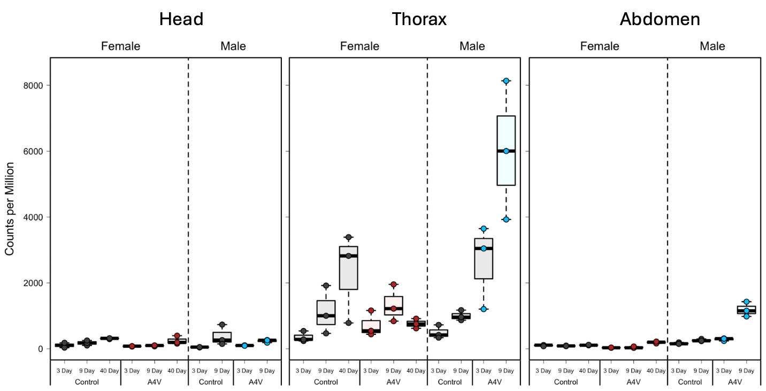
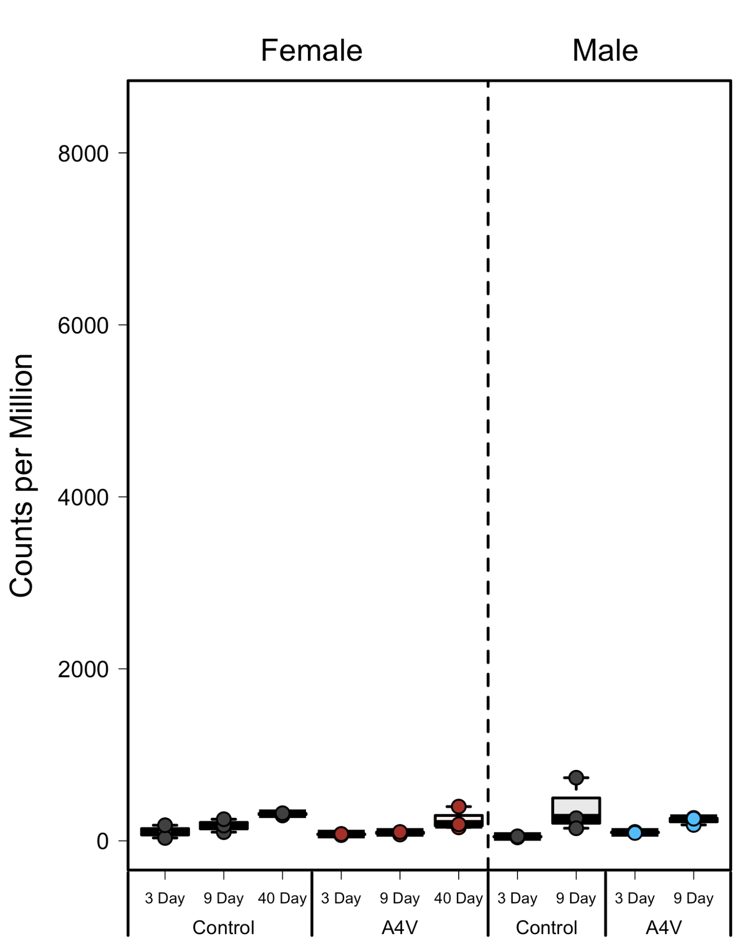
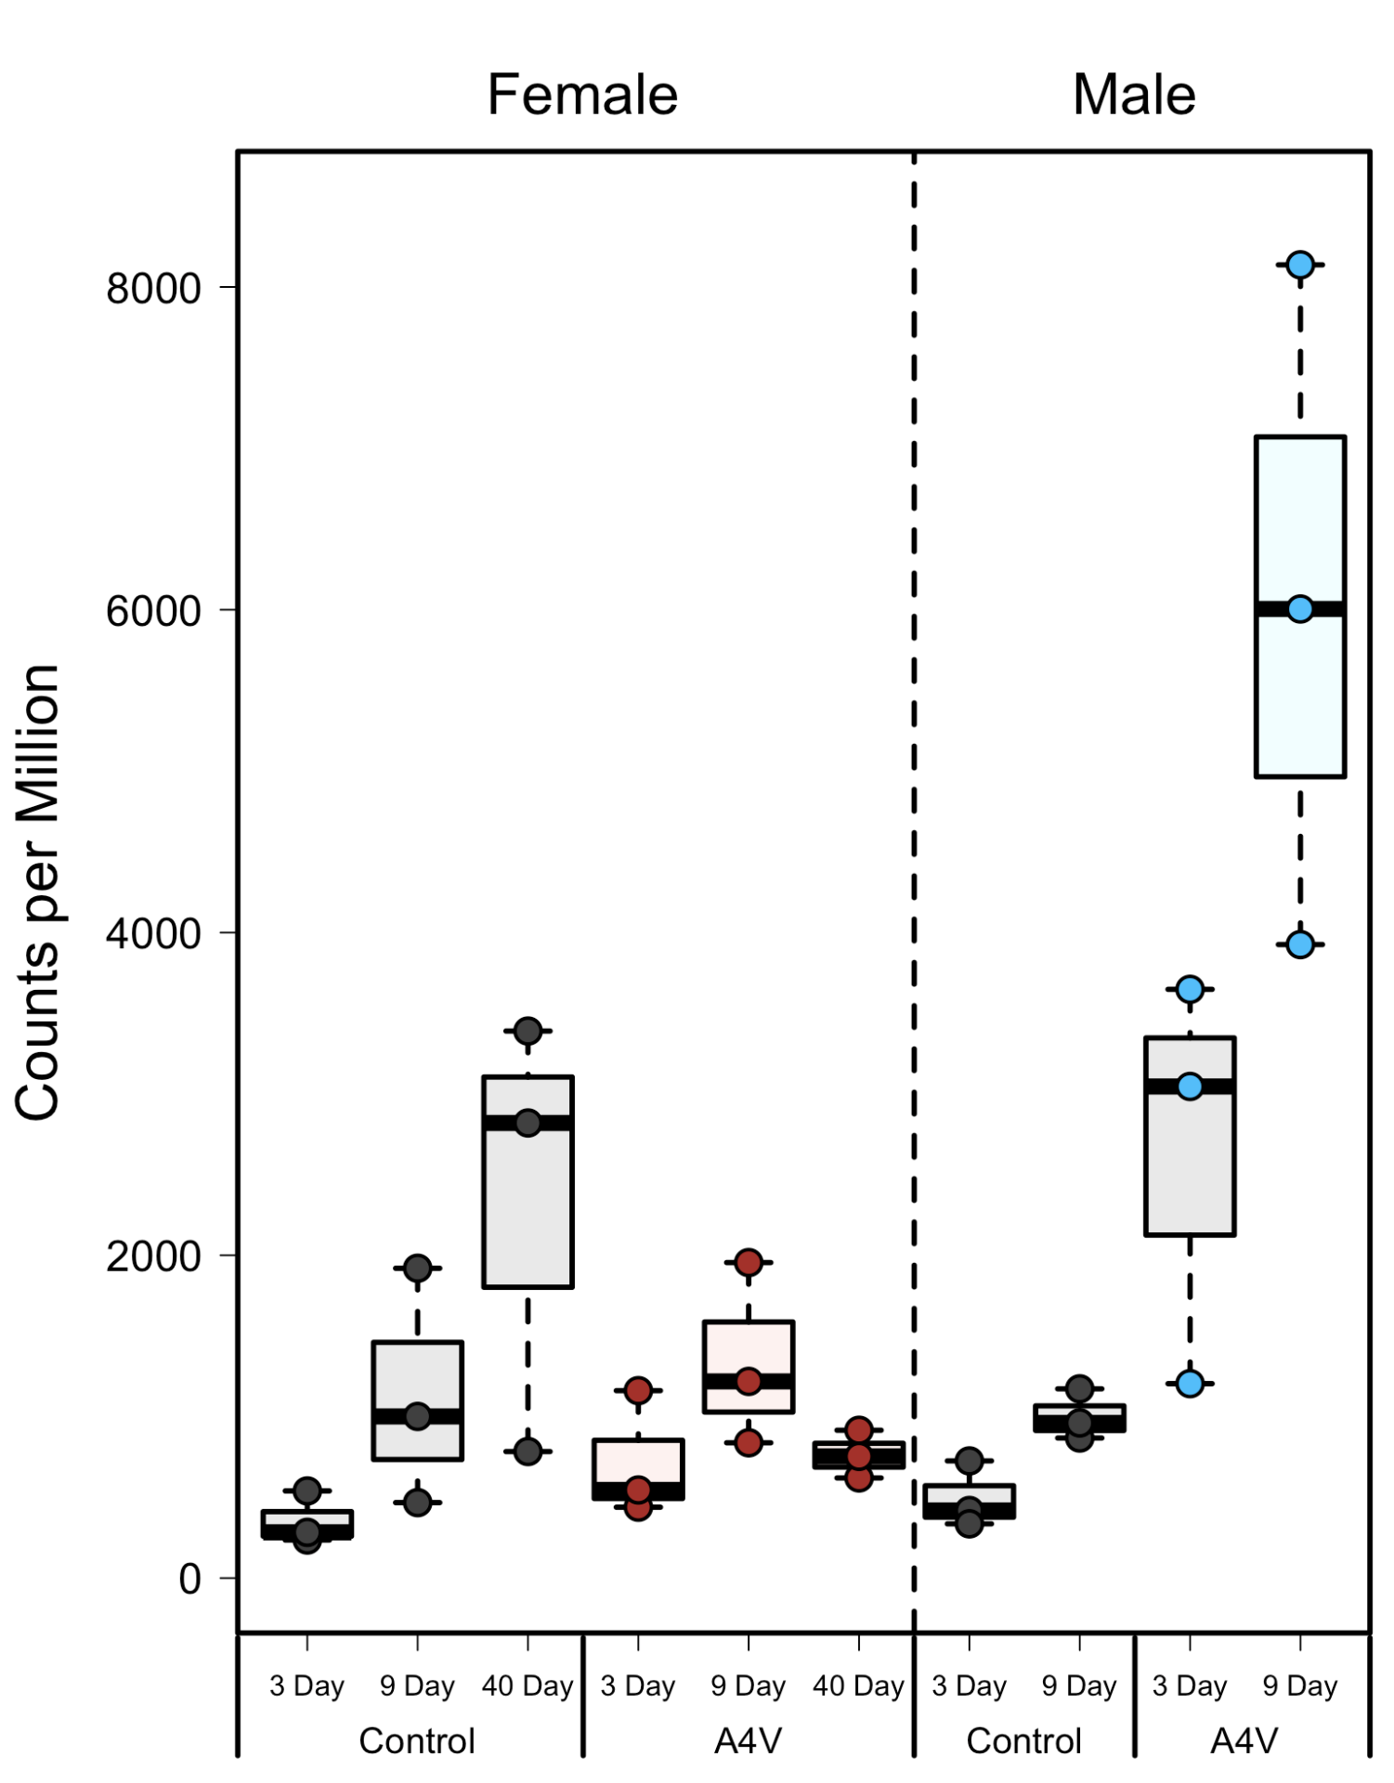
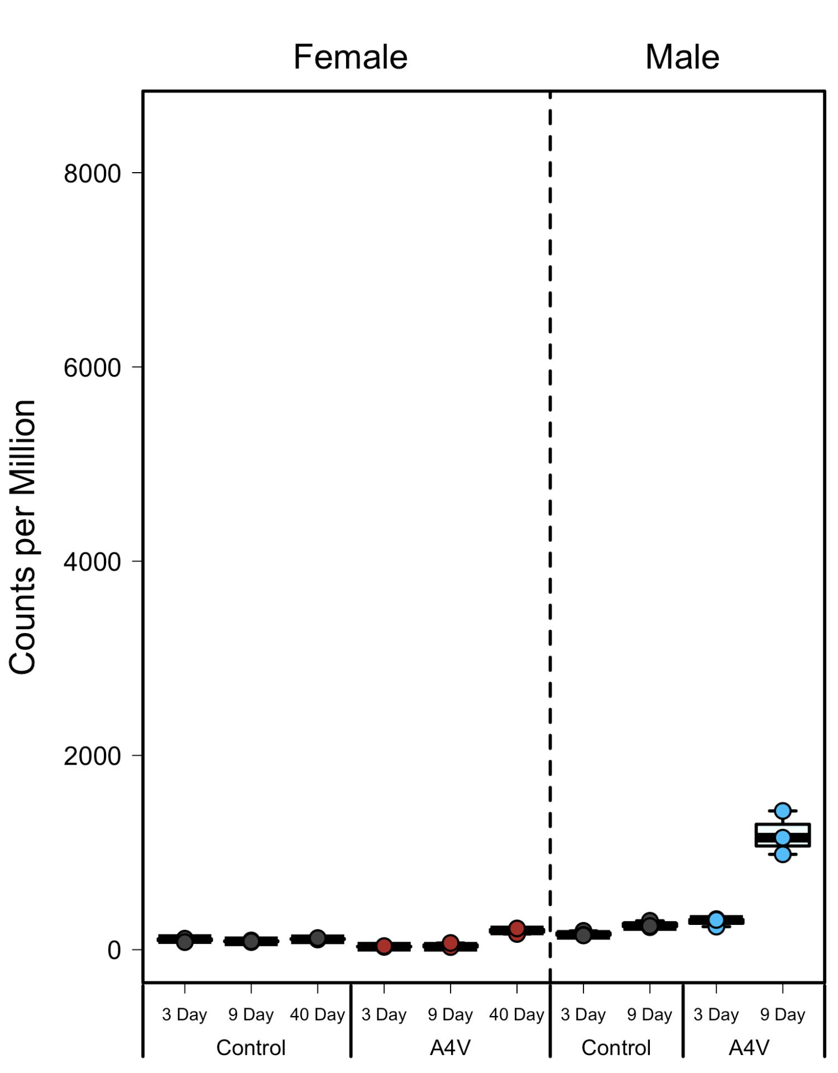
Arc1 Expression in Sod1^{A4V}
Head
Thorax
Abdomen

Slide 11
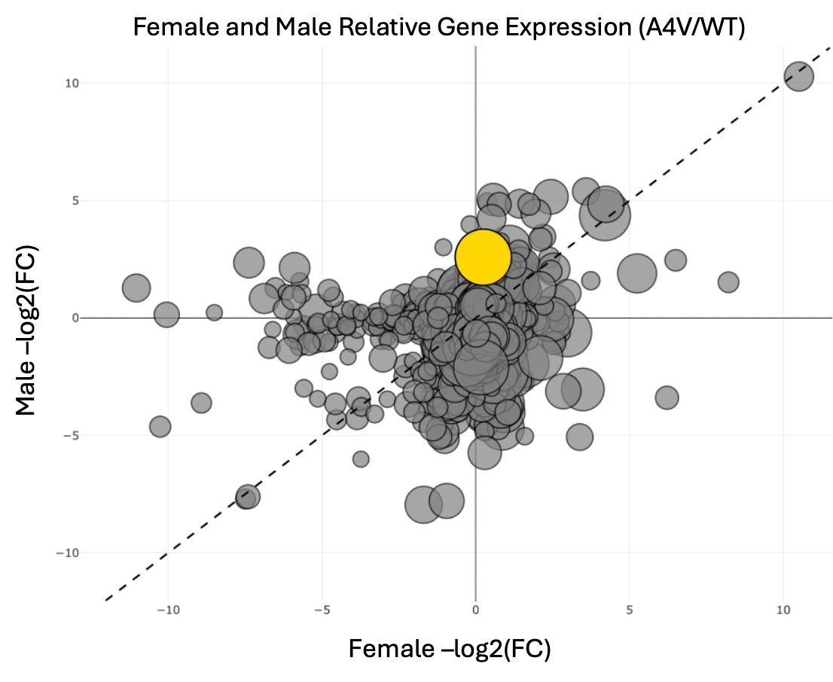
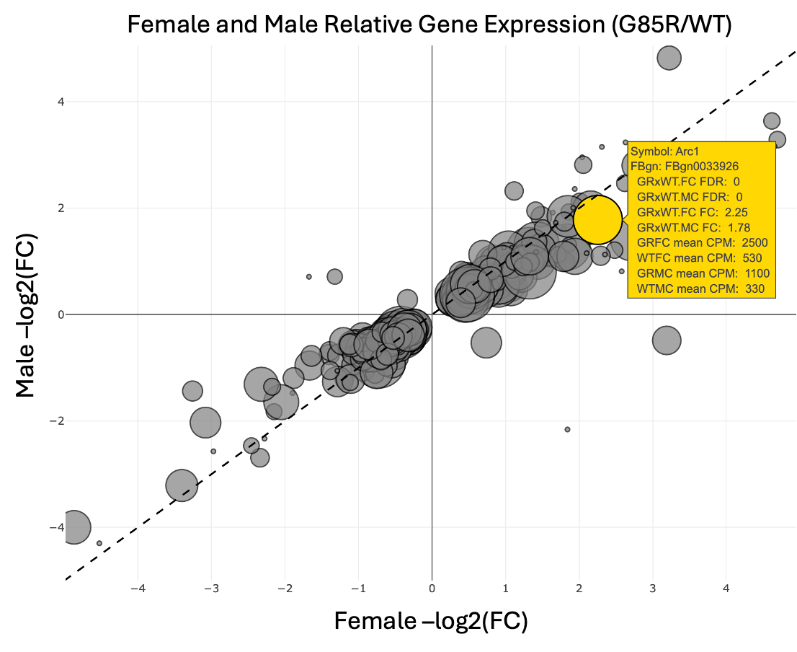
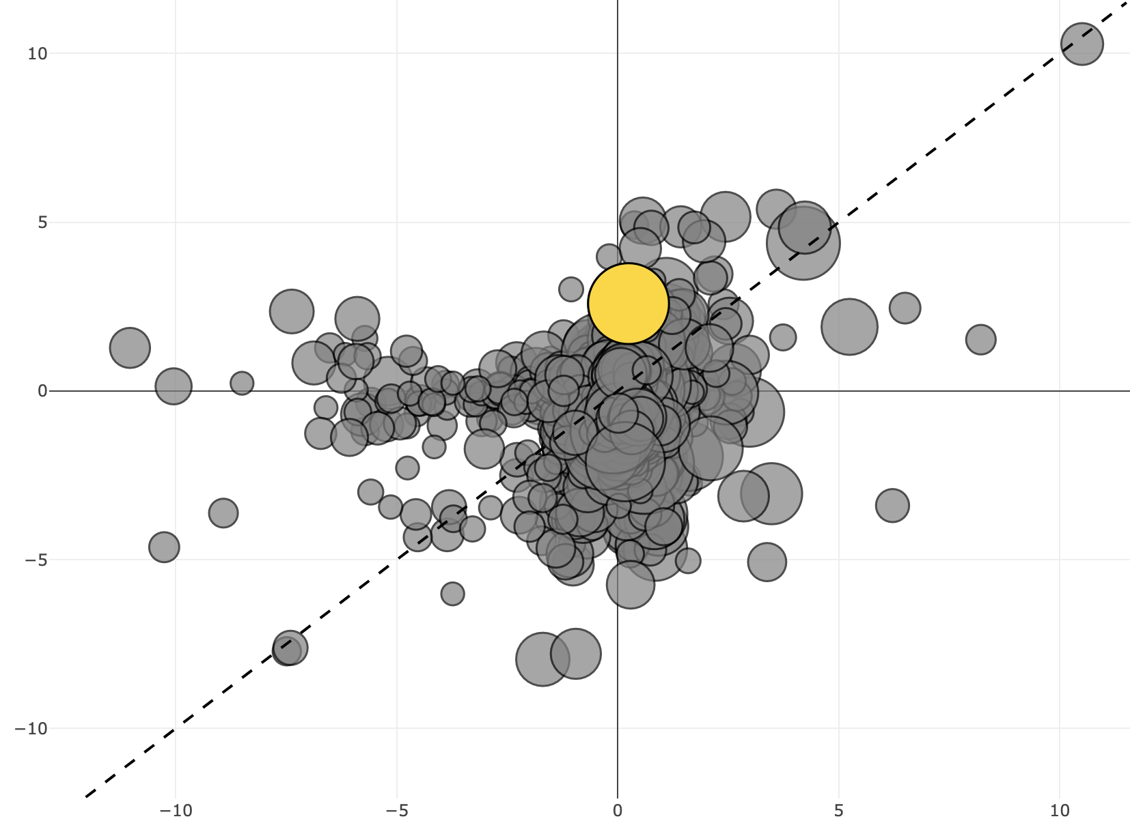
Distinct Sex Differences in Sod1^{A4V} Transcriptome
Female and Male Relative Gene Expression (A4V/WT)
Male –log2(FC)
Unlike in Sod1^{G85R} larvae, the transcriptome profiles between male and female Sod1^{A4V} thorax samples
Female –log2(FC)

